Slide 1
Capturing Requirements
Zeeshan Ali Rana

Slide 2
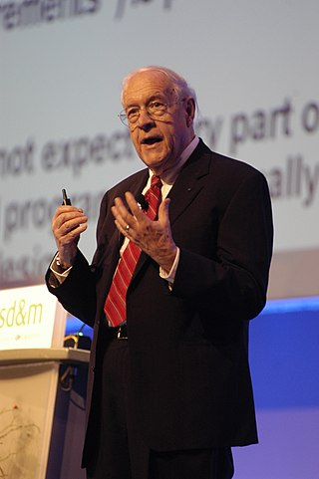
The hardest single part of building a software system is deciding what to build.
Fred Brooks

Slide 3
Requirements
A requirement is an expression of desired behaviour
Requirements focus on the customer needs, not on the solution or implementation
designate what behaviour, without saying how that behaviour will be realized

Slide 4
Requirement Format
Standard form:
The [noun phrase] shall (not) [verb phrase]
Noun phrase is the main subject of the requirement e.g. system
Shall (not) indicates a required (or prohibited) behavior
Verb phrase indicates the action of the requirement
Example
The system shall reject untagged baggage
The system shall not reject damaged baggage
Standard form with hierarchical numbering
[identifier] The [noun phrase] shall (not) [verb phrase]

Slide 5
Requirement Format
Standard form with hierarchical numbering and constraints
[identifier] The [noun phrase] shall (not) [verb phrase] [constraint phrase]
Example
1.2.1 The system shall reject untagged baggage within 5 seconds of identification

Slide 6
Types of Requirements
Business
User
Functional
Non-Functional
We need a time series model for the purpose of forecasting demand
User can upload a file with sales records
The system shall allow the users to make monthly forecasts
The system shall allow the users to make monthly forecasts with 70% accuracy

Slide 7
Types of Requirements
Functional requirement
Describes: interaction between the system and its environment, how should the system behave given certain stimuli, required behaviour in terms of required activities
Example: For a system of printing pay cheques the functional requirements must answer the following:
What input is necessary for a pay cheque to be printed?
Non-functional requirement
Describes: some quality characteristic that the software must posses, a restriction on the system that limits our choices for constructing a solution
Constraints could be:
Design constraint: a design decision such as choice of platform or interface components
Process constraint: a restriction on the techniques or resources that can be used to build the system
Example: queries to the system must be answered within 3 seconds
Both types of requirements are elicited from the customer in a formal, careful way.

Slide 8
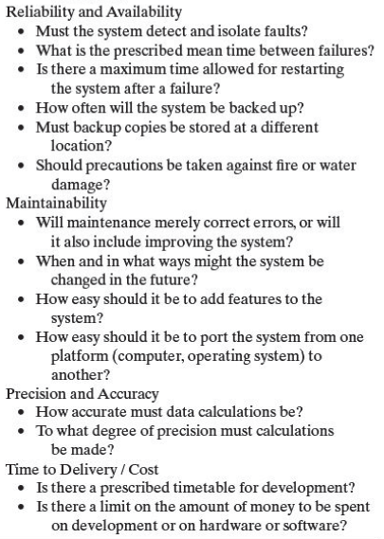
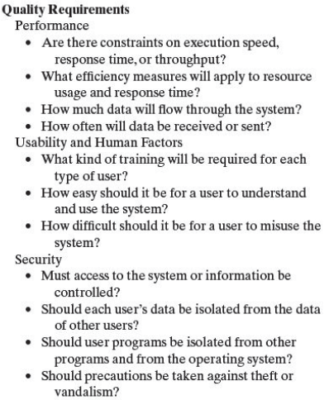
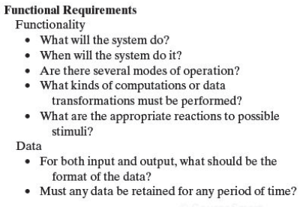

Slide 9
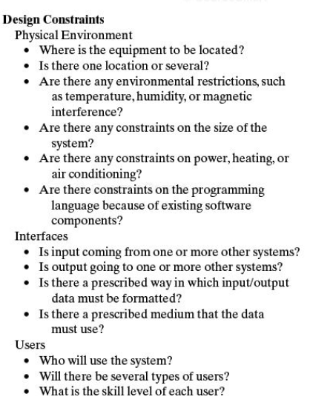
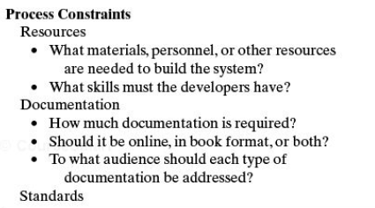
Capturing more NFRs

Slide 10
Functional/Non Functional
System shall allow the user to enter valid credentials and access any features of the system.
The system shall allow the user to inquire about the status of a sensor.
The HRIS shall complete the employee attendance report check within 10 seconds of the request.
When communicating, the system shall encrypt data to keep the data safe.
The system shall show a picture of the security control panel after login.

